Slide 1
Basics of C
Session 1

Slide 2
Objectives
Differentiate between Command, Program and Software
Explain the beginning of C
Explain when and why is C used
Discuss the C program structure
Discuss algorithms
Draw flowcharts
List the symbols used in flowcharts
Elementary Programming with C/Session 1/ <number> of 26

Slide 3
Software, Program and Command
Software
Program 1
Program 2
Commands
Commands
Commands
Elementary Programming with C/Session 1/ <number> of 26

Slide 4

The Beginning of C
BPCL – Martin Richards
B – Ken Thompson
C – Dennis Ritchie
Elementary Programming with C/Session 1/ <number> of 26

Slide 5
Application Areas Of C
C was initially used for systems programming
A system program forms a portion of the operating
system of the computer or its support utilities
Operating Systems, Interpreters, Editors, Assembly
programs are usually called system programs
The UNIX operating system was developed using C
There are C compilers available for almost all types
of PC’s
Elementary Programming with C/Session 1/ <number> of 26

Slide 6
Middle Level Language
High Level Language
C
Assembly Language
Elementary Programming with C/Session 1/ <number> of 26

Slide 7
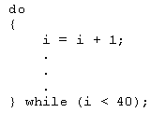
Structured Language
C allows compartmentalization of code and data
It refers to the ability to section
off and hide all information and
instructions, necessary to
perform a specific task, from the
rest of the program
Code can be compartmentalized in C by using
functions or code blocks.
Elementary Programming with C/Session 1/ <number> of 26

Slide 8
About C
C has 32 keywords
These keywords combined with a formal syntax
form a C programming language
Rules to be followed for all programs written in C:
All keywords are lowercased
main()
{
/* This is a sample Program*/
int i,j;
i=100;
j=200;
:
}
C is case sensitive, do while is different from DO WHILE
Keywords cannot be used as a variable or function name
Elementary Programming with C/Session 1/ <number> of 26

Slide 9
The C Program Structure-1
main()
Elementary Programming with C/Session 1/ <number> of 26

Slide 10
The C Program Structure-2
Delimiters { ... }
Elementary Programming with C/Session 1/ <number> of 26

Slide 11
The C Program Structure-3
Statement Terminator .... ;
Elementary Programming with C/Session 1/ <number> of 26

Slide 12
The C Program Structure-4
/* Comment Lines */
Elementary Programming with C/Session 1/ <number> of 26

Slide 13
The C Library
All C compilers come with a standard
library of functions
A function written by a programmer
can be placed in the library and used
when required
Some compilers allow functions to
be added in the standard library
Some compilers require a separate
library to be created
Elementary Programming with C/Session 1/ <number> of 26

Slide 14
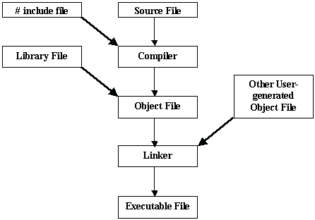
Compiling & Running A Program
Elementary Programming with C/Session 1/ <number> of 26

Slide 15




The Programming Approach to Solving Problems
Classroom
Algorithm is a set of steps that are performed to solve a problem. The example below describes an algorithm
Leaving the
classroom
Head towards
the staircase
Go to the
basement
Head for the
cafeteria
These are the steps followed when a student wants to go to the cafeteria from the classroom
Cafeteria
Elementary Programming with C/Session 1/ <number> of 26

Slide 16
Solving a Problem
In order to solve a problem
Understand the problem clearly
Gather the relevant information
Process the information
Arrive at the solution
Elementary Programming with C/Session 1/ <number> of 26

Slide 17
Pseudocode
It is not actual code. A method of algorithm - writing which uses a standard set of words which makes it resemble code
BEGIN
DISPLAY ‘Hello World !’
END
Each pseudocode starts with a BEGIN
To show some value , the word DISPLAY is used
The pseudocode finishes with an END
Elementary Programming with C/Session 1/ <number> of 26

Slide 18
Flowcharts
It is a graphical representation of an algorithm
START
DISPLAY ‘Hello World !’
STOP
Elementary Programming with C/Session 1/ <number> of 26

Slide 19
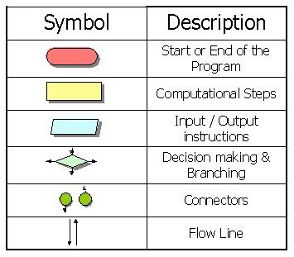
The Flowchart Symbol
Elementary Programming with C/Session 1/ <number> of 26

Slide 20
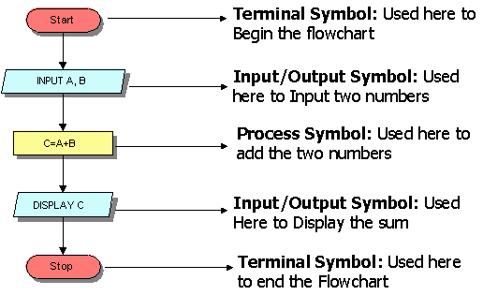
Flowchart to add two numbers
Elementary Programming with C/Session 1/ <number> of 26

Slide 21
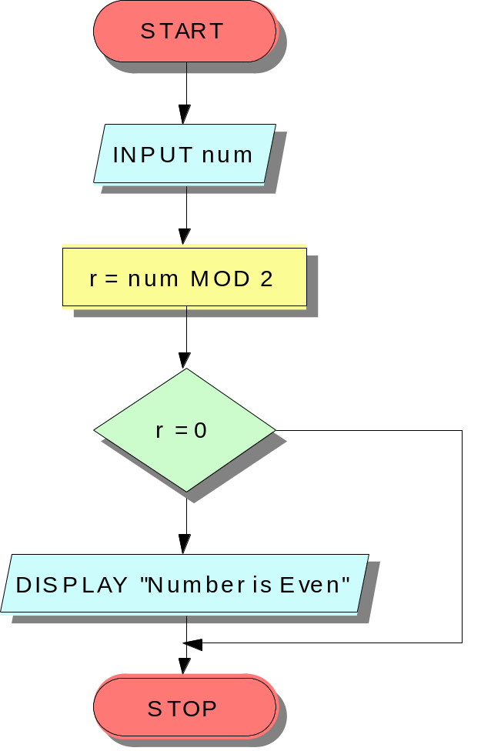
The IF Construct
BEGIN
INPUT num
r = num MOD 2
IF r=0
Display “Number is even”
END IF
END
No
Yes
Elementary Programming with C/Session 1/ <number> of 26

Slide 22
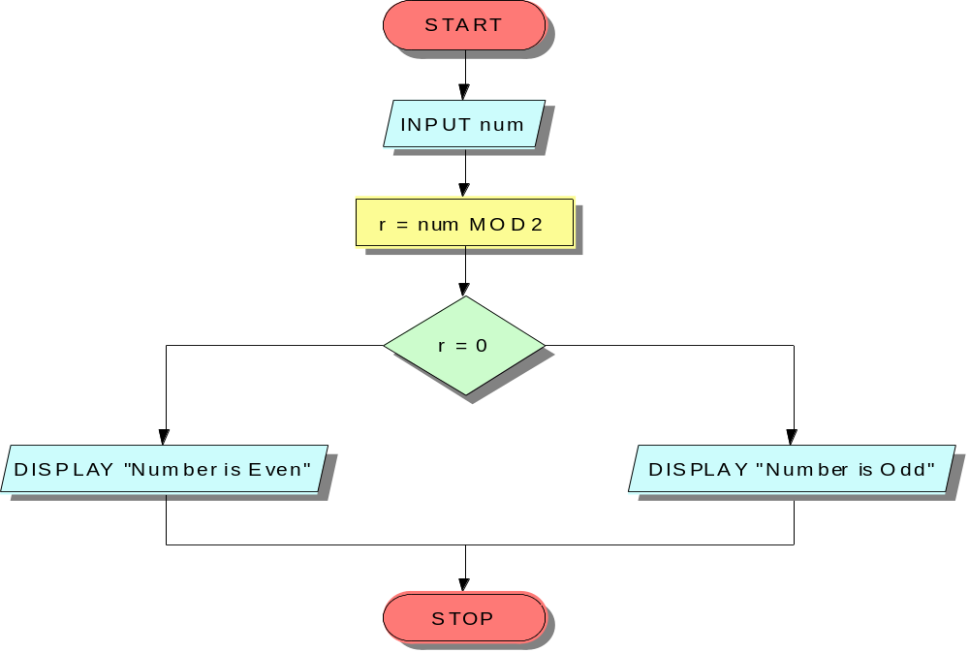
The IF-ELSE Construct
BEGIN
INPUT num
r=num MOD 2
IF r=0
DISPLAY “Even Number”
ELSE
DISPLAY “Odd Number”
END IF
END
Yes
No
Elementary Programming with C/Session 1/ <number> of 26

Slide 23
Multiple criteria using AND/OR
BEGIN
INPUT yearsWithUs
INPUT bizDone
IF yearsWithUs >= 10 AND bizDone >=5000000
DISPLAY “Classified as an MVS”
ELSE
DISPLAY “A little more effort required!”
END IF
END
Elementary Programming with C/Session 1/ <number> of 26

Slide 24
Nested IFs-1
BEGIN
INPUT yearsWithUs
INPUT bizDone
IF yearsWithUs >= 10
IF bizDone >=5000000
DISPLAY “Classified as an MVS”
ELSE
DISPLAY “A little more effort required!”
END IF
ELSE
DISPLAY “A little more effort required!”
END IF
END
Elementary Programming with C/Session 1/ <number> of 26

Slide 25
Nested IFs-2
START
INPUT YearsWithUs
INPUT bizDone
YES
YearsWithUs >= 10
NO
DISPLAY “A Little more effort required”
NO
bizDone > 5000000
YES
DISPLAY “A Little more effort required”
DISPLAY “Classified as an MVS”
Elementary Programming with C/Session 1/ <number> of 26
STOP

Slide 26
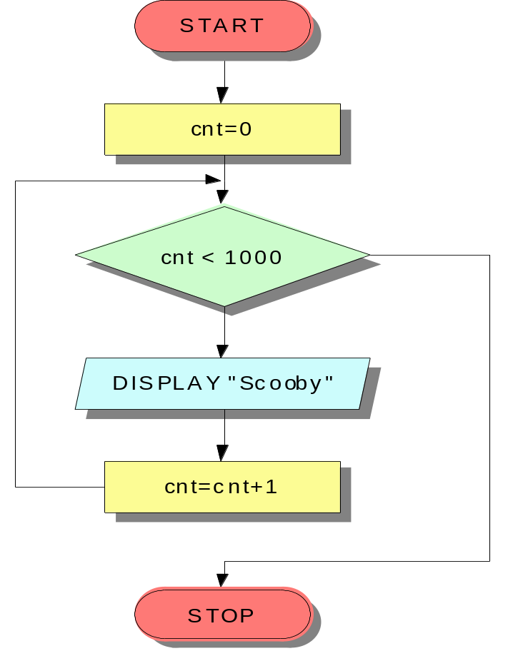
Loops
BEGIN
cnt=0
WHILE (cnt < 1000)
DO
DISPLAY “Scooby”
cnt=cnt+1
END DO
END
No
Yes
Elementary Programming with C/Session 1/ <number> of 26

